Slide 1
MOLSIM Presentation
Andrew Kullman

Slide 2
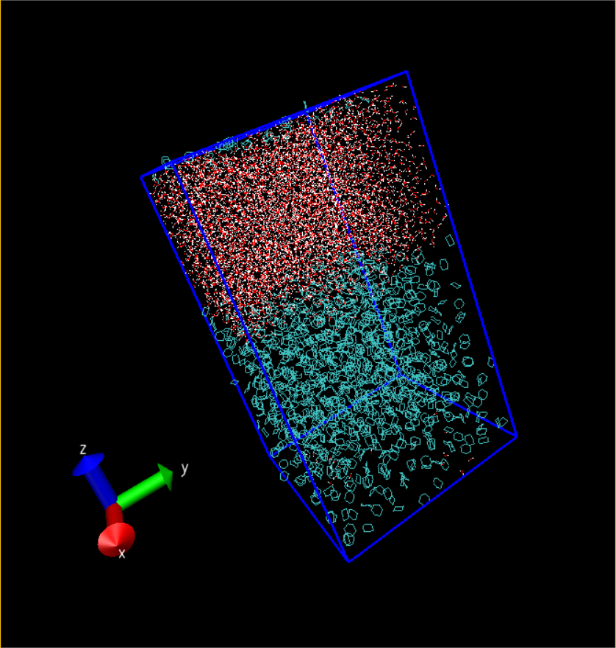
The project:
Set up the box with water and cyclohexane
Performed energy minimization, and equilibration on the system
Production run
Set up a new box with KALP15 inserted into the water
Performed the same equilibration steps
Production run

Slide 3
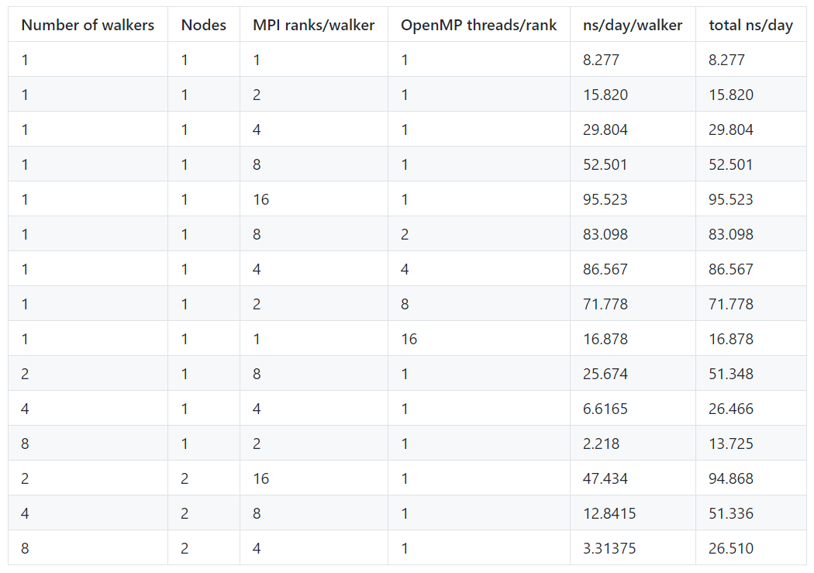

Slide 4
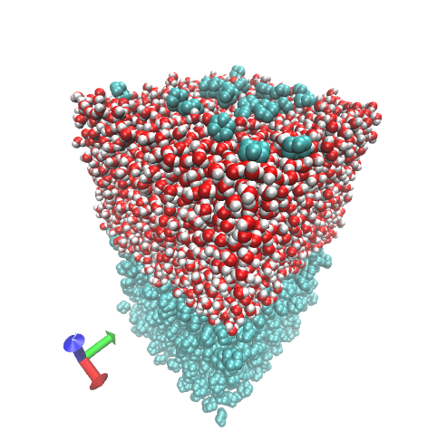

Slide 5
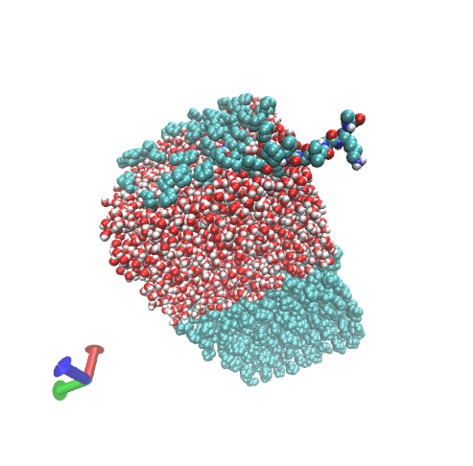

Slide 6
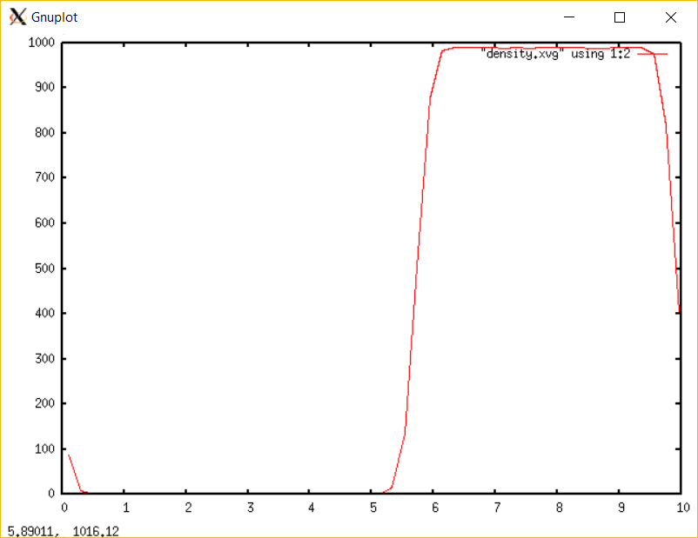
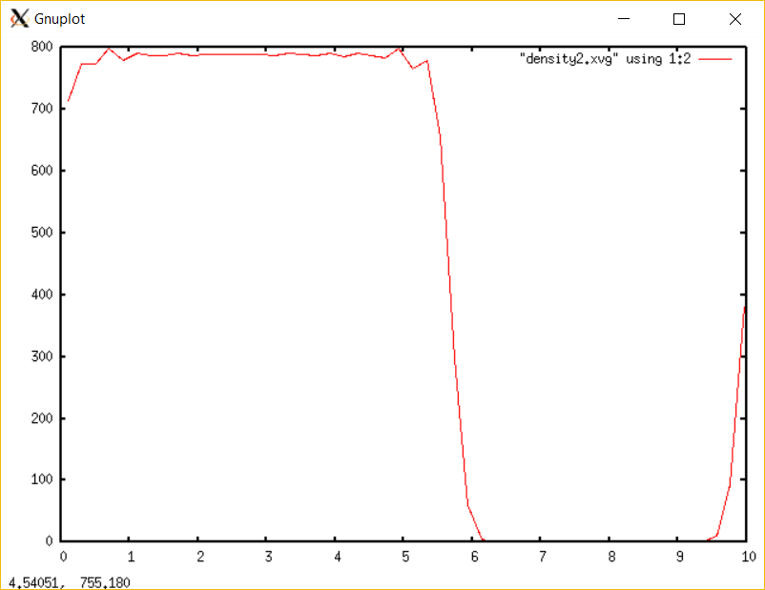
Density (kg/m3) as a function of distance along the z axis:
Water
Cyclohexane

Slide 7
Further Analysis:
Look at trajectory and investigate what happened to the peptide in the water
Insert peptide into the cyclohexane and compare results
Experiment with VDW radius sizes look specifically at the interface between water and cyclohexane
Look into using similar peptides and compare to KALP15

